Slide 1
Citicard - Expenses
How to Connect 2 GL accounts to the same receipt
Or
How to Connect 2 - TA’s to the same Report due to spending more than the original TA

Slide 2
The steps are the same for both instances.
You must have approved Tauthorizations and be ready to create your Expense
Step #1 Click the date hyperlink to open the Citibank charge
Note: if you have already created a report and have a box at the top of your screen just “open” the box.

Slide 3
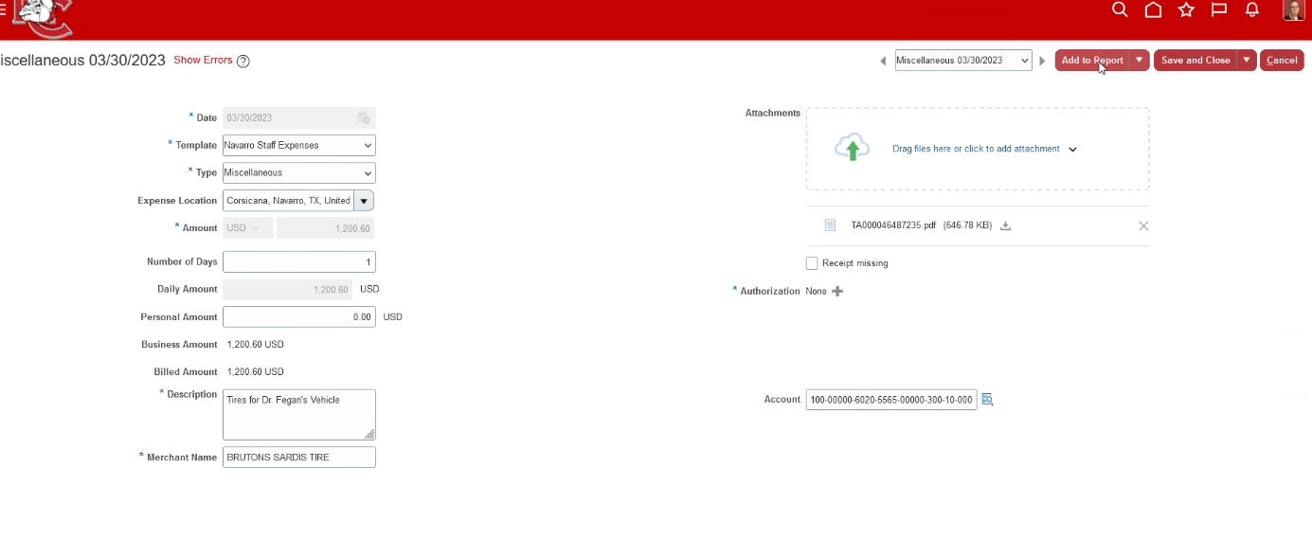
Step #2 – Fill out the description – Merchant Name – Connect your Receipt
DO NOT connect your Authorization or fill in the GL account
Step #3 – Add to Report
X
X

Slide 4
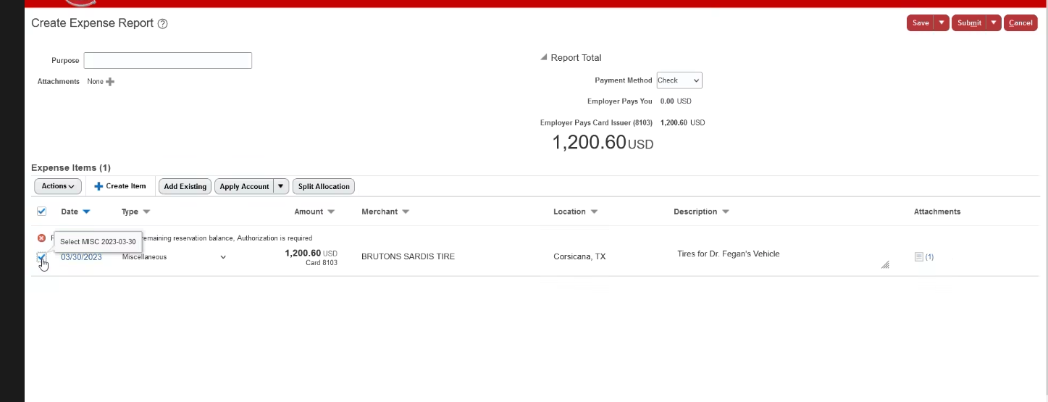
Step #4 – Click the box next to the date you previously used (the Expense you are working on)
Step #5 – Click on Split Allocation

Slide 5
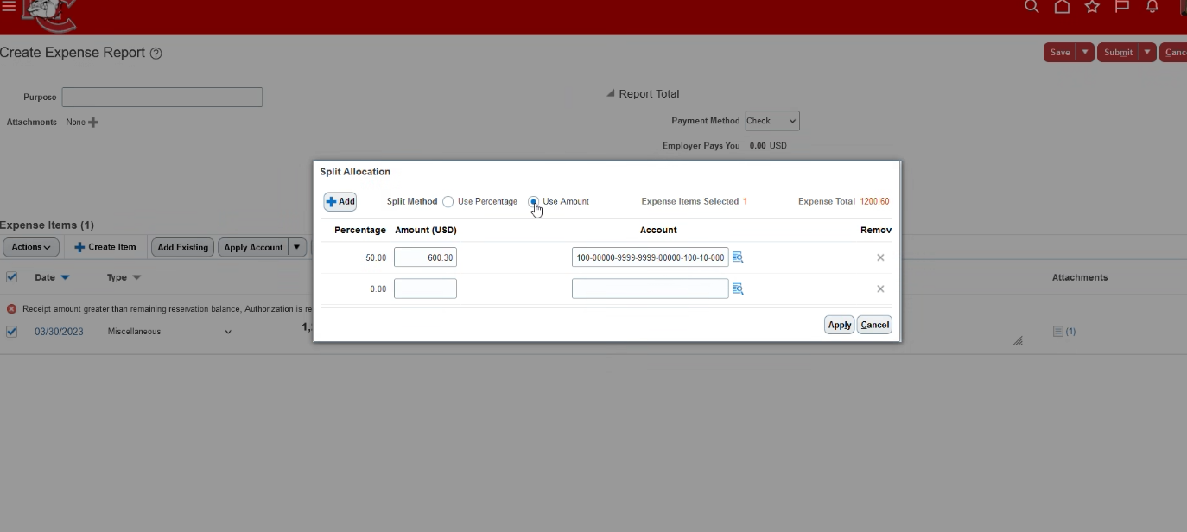
Step #6 – Click Use Amount (to change the amount – it defaults to percentage)
Step #7 – put in the amounts and gl account codes you used on the Tauthorizations
(Note: it automatically jumps to the second line on the gl account)
Step #8 – Apply – Submit

Slide 6
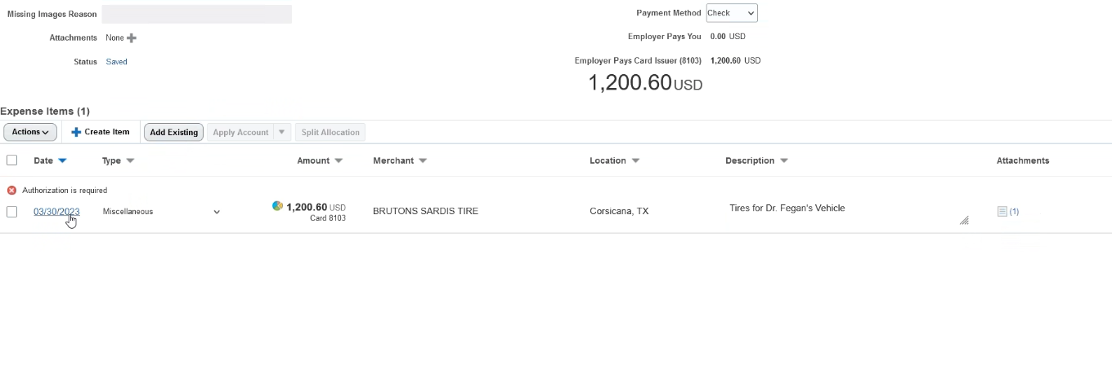
Step #9 - Click the date hyperlink to open the Citibank charge again!
Notice the pie chart showing you are making split allocations

Slide 7
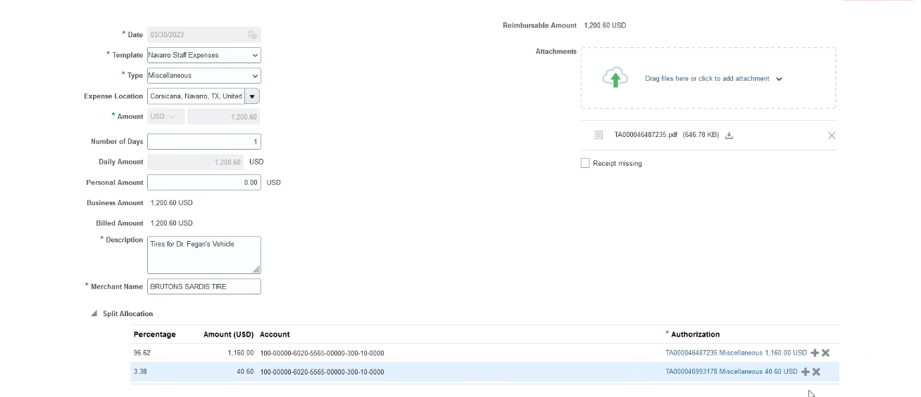
Step #10 – Click on the arrow to “OPEN” Split Allocation
Step #11 - Click on each + to add your Tauthorization
Step #12 – Save & Close

Slide 8
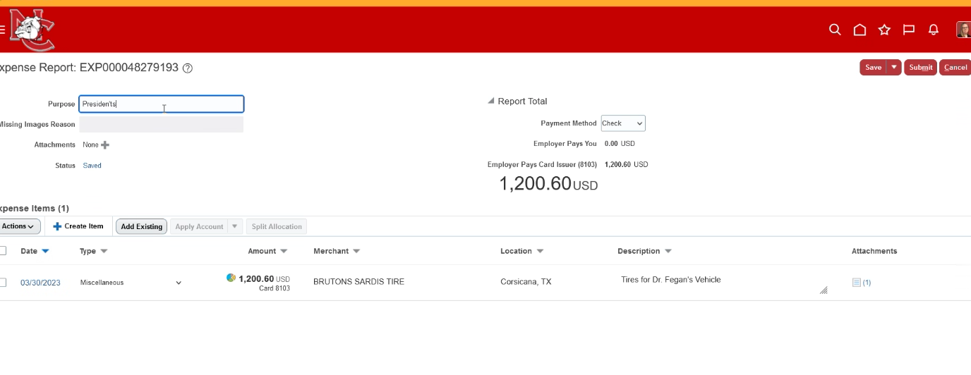
Step # 13 - Don’t forget your purpose
Step #14 – Submit

